Slide 1
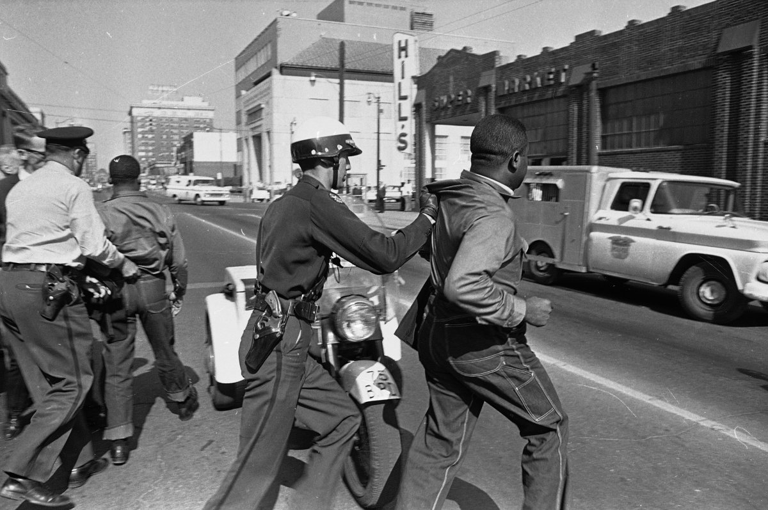
WE’VE GOT A JOB: CHAPTER 10-VIEWS FROM OTHER SIDES
WHAT WERE THEY THINKING?
By: Gavin Aco and Julia Godinez

Slide 2
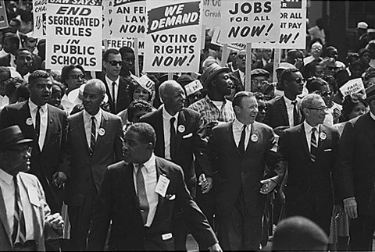
Summary
Views were separate during the white community; some of them were overwhelmingly racist, and a few supported the cause. The majority of people who supported integration usually don’t come out in the open, afraid of what others will think. The KKK usually harassed the whites that are openly supportive of blacks while they’re driving home, publishing their face and address on newspapers. The movement also affected business, since customers wouldn’t want to work with a person who supported blacks.

Slide 3
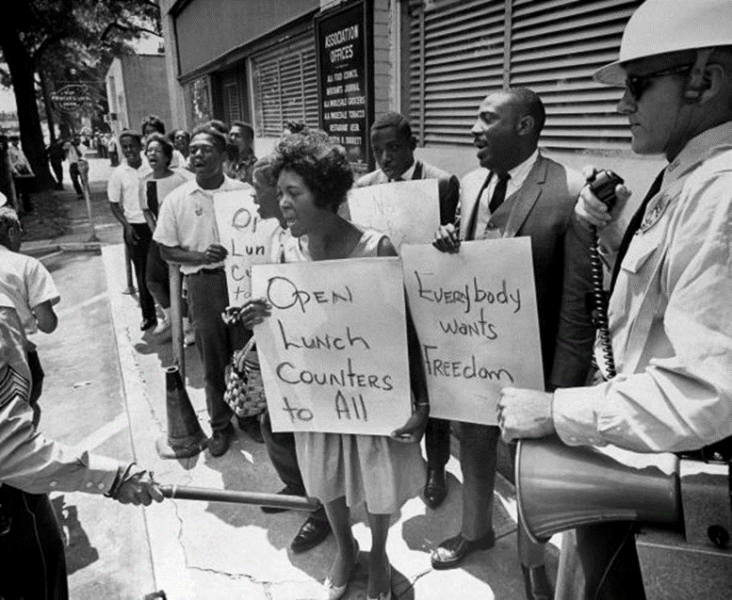
Main Points
White people were very determined to keep blacks off their lunch counter stools and out of their schools and swimming pools.
Officials were allowed to imprison, interrogate, hose, and set vicious dogs on their children.
A majority of the people in Birmingham did not want interrogation.
Many white people were against interrogation because they strongly agreed that whites was better than the blacks.
A few white people quietly supported integration, but most whites supported Bull Connor.
A few policemen opposed segregation.
Those who opposed segregration were often threatned by the KKK by receving threatning phone calls.
There was a cotton curtain in Alabama. A Cotton Curtain is when “News didn’t come in, and news didn’t get out”.

Slide 4
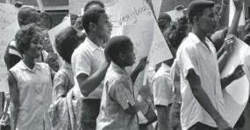
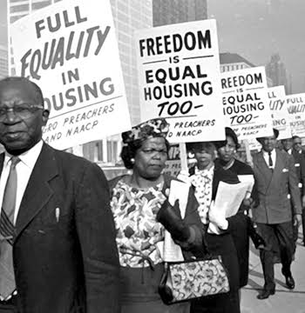
Main Characters
Reverend Joseph Ellwanger
Diane McWhorter ( She went to school with the one who played Scout in the movie To Kill a Mocking Bird).
Pam Walbert
Audrey Hendricks
Bull Connor

Slide 5
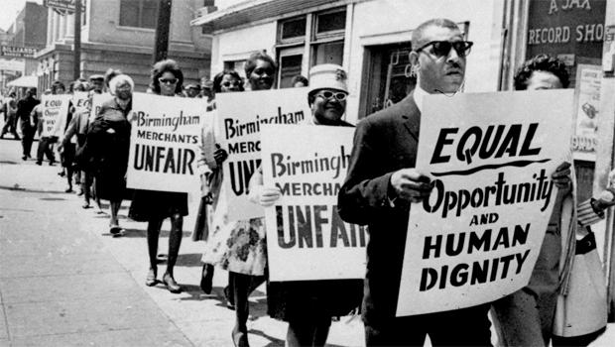
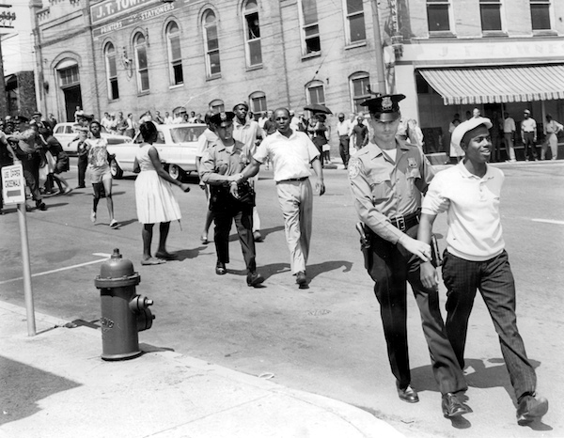
Catholic Perspective
As Catholics, all people should be treated the same no matter what race they are.
We are all equal in the eyes of God.
People shouldn’t harm others based on their race.

Slide 6
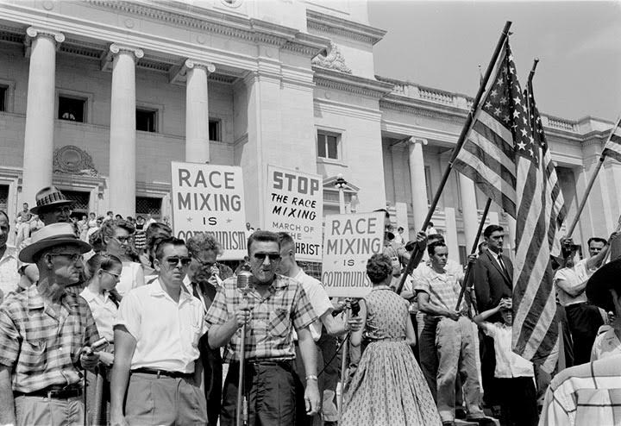
Power of Words/Actions
During the rights movement, people who opposed believed that whites were the superior race. The power of words in this chapter is how a group of people, not just blacks, but also a few whites, speaking their opinion about racial equality, and demanded to break the line of segregation, regardless of what others would think.

Slide 7
THE END
Thank You for Listening!

